Slide 1
Learning Objectives:
Friday’s Recap:
Identify the shifts in public opinion since WWII
Herrmann’s “Attachment to the Nation” article
Today’s Agenda
Unpacking “motivated reasoning”—how attachments to the Nation (emotions) shape peoples’ beliefs and policy preferences in foreign policy.
The role of the media in democracies
Discuss different factors that influence foreign news coverage in the US

Slide 2
Motivated Reasoning
Primary purpose is to avoid painful cognitive tradeoffs (i.e. cognitive dissonance)
Two examples:
When people face a choice between two values they sometimes construct a mental picture that dissolves the tradeoff (Steinbruner 1974)
instead of seeing guns coming at the expense of butter someone might construct a mental picture in which an investment in guns has spinoffs that increase the production of butter.
Heider (1985) found that tradeoffs between feelings of like and dislike make people deeply uncomfortable.
Negative information about someone you like vs positive information about someone you dislike
Mercer (2010) finds, the more intense the emotions get the more difficult it is for the observer to recognize that other people could legitimately see it another way.

Slide 3
Research Question & Theory:
Herrmann’s argument tries to explain when emotions will fire, for whom, and how that will shape the formation of conscious beliefs.
Based on social identity theory: people derive some of who they are from attributes they personally possess and part of who they are from the groups they belong to (Brown 2000; Tajfel 1981).
When emotions of dislike and feelings of threat become strong, the most typical motivated belief is an enemy image (Silverstein 1989).

Slide 4
Hypotheses:
Attachment and Interpretation
H1: Attachment to the nation associates positively with more intense emotional appraisals of the international situation. In other words, as attachment increases so does the judgment that potentially threatening situations represent bigger problems.
International Trust
H2: As national attachment increases so will the inclination to attribute defensive intentions to countries that are liked and aggressive intentions to countries that are disliked.
Action & Policy
H2a: As national attachment increases so will the inclination to punish countries that are disliked and to forgive those that are liked when the two are doing the same thing that can be seen as violating a norm.

Slide 5
Results:
It appears that national attachment as well as chauvinism motivate people to interpret and react to the same act differently depending on the country involved.
That is because the countries evoke different emotions that motivate the construction of beliefs that allow the observer to apply normative standards in different ways while believing they are abiding by these standards.
Likewise, beliefs about situations and what is normatively appropriate follow as much from attachment to the nation and the emotional desires this gives rise to as they do from the norm itself.

Slide 6
Functions of the News Media
Source of information and opinions
Correspondents often on scene providing live coverage of wars and supplement coverage of international events
Agenda setter
Coverage of issues bolsters opinions that the topic is important
Government watchdog
Investigative reports reveal government abuses such as occurred at Abu Ghraib prison
Notes:
Learning Objective number: 8.1

Slide 7
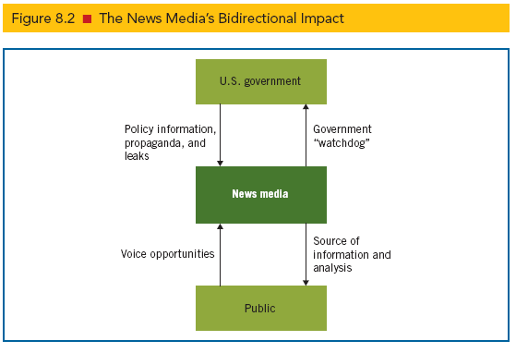
Functions of the News Media
Notes:
Learning Objective number: 8.1

Slide 8
Patterns of Foreign News Coverage
Vast expansion of field of journalism
Hundreds of cable channels, thousands of Internet sources, social media, traditional news sources (local newspapers, television) threatened by foreign news sources and blogs
Selective exposure: Due to many choices, people seek news that matches their interests
News journalists moving from neutral messengers to advocates
Group identities shape media consumption patterns.
Declining interest in foreign news
Associated Press and Reuters provide foreign wires to most news services
Consumers rank foreign news less important than state and local and national news
Notes:
Learning Objective number: 8.2

Slide 9
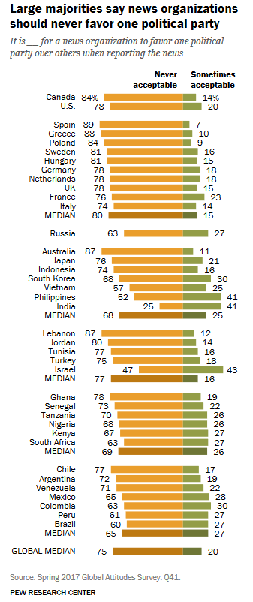
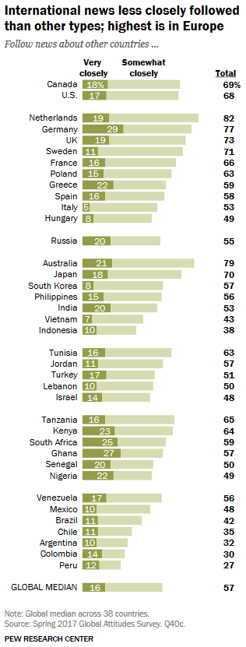
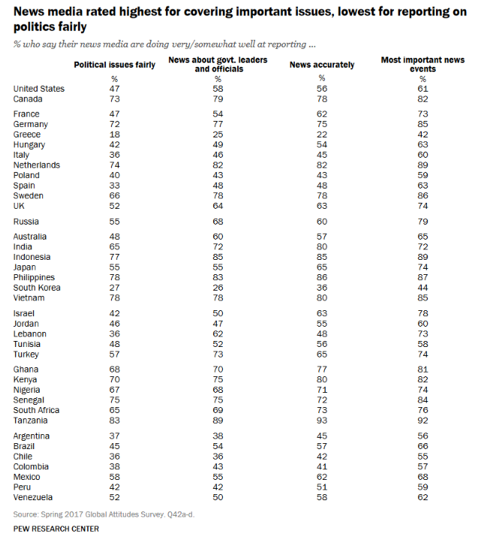
PEW Research (2018):

Slide 10
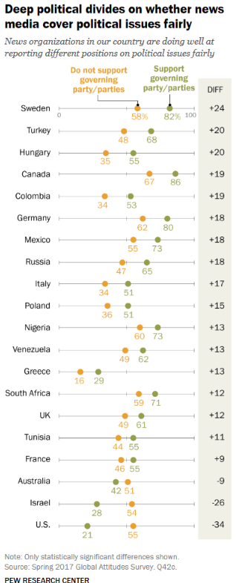
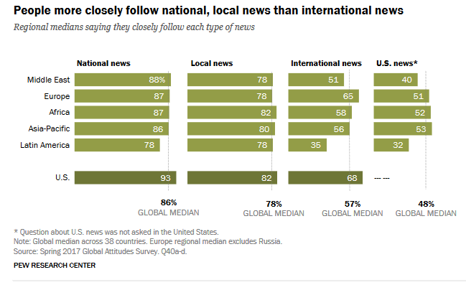
PEW Research (2018)

Slide 11
Evolving Technologies and Media Coverage
Technology constantly changing how news is delivered
Newspapers, radio, television, and the Internet
Vietnam War was important turning point: First “living-room war,” with live military action viewed by the public
Changes in who provides the news
Coverage of foreign affairs has increased over time
Cable networks produce 24-hour news shows
“Rooftop journalism” during the Persian Gulf War; news personnel provided live coverage during U.S. attacks in Iraq
Coverage dominated by networks owned by media conglomerates and large corporations, such as General Electric, News Corp, Disney, Viacom, Time Warner, and CBS
Conflicts of interest?
Notes:
Learning Objective number: 8.2

Slide 12
Characteristics of World News
Six key factors of foreign news coverage in the U.S.
From print to video: Print revenues falling since CNN appeared in the 1980s
The rise of niche media: Appearance of specialty publications has increased exposure to controversial topics
U.S. centrism: Foreign topics connected as much as possible to U.S. events to catch the attention of U.S. consumers
Conflict orientation: Media emphasizes conflict to capture attention of consumers, resulting in negative misperceptions of U.S. public that world is chaotic
Superficiality: In-depth coverage avoided in favor of parachute journalism
Arbitrariness: Coverage guided by immediacy and crisis rather than principles and long-term priorities
Notes:
Learning Objective number: 8.2

